Slide 1
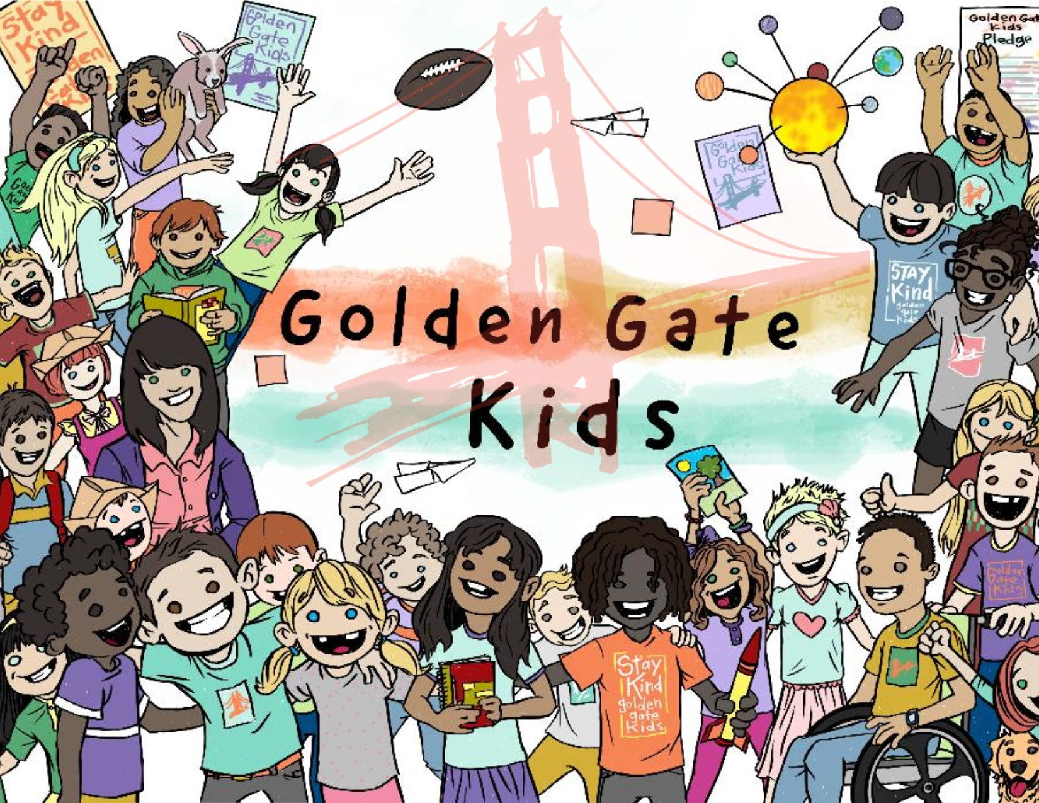
Pro-social
Connection
Bridge
Builder
Notes:
Pro-social behavior is defined as kindness, inclusion, positivity, and outreach. The Golden Gate Kids Program empowers students to connect with peers through this approach.
Golden Gate Research is showing that students are experiencing social anxiety, they feel excluded, invisible, unaccepted, and alone. Connection is Crucial to our students emotional and mental health.
Students will learn to become a Bridge Builder. They will be instructed in the life skills that will help them build their best selves and others around them.

Slide 2
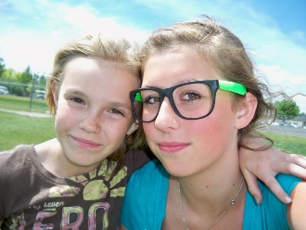
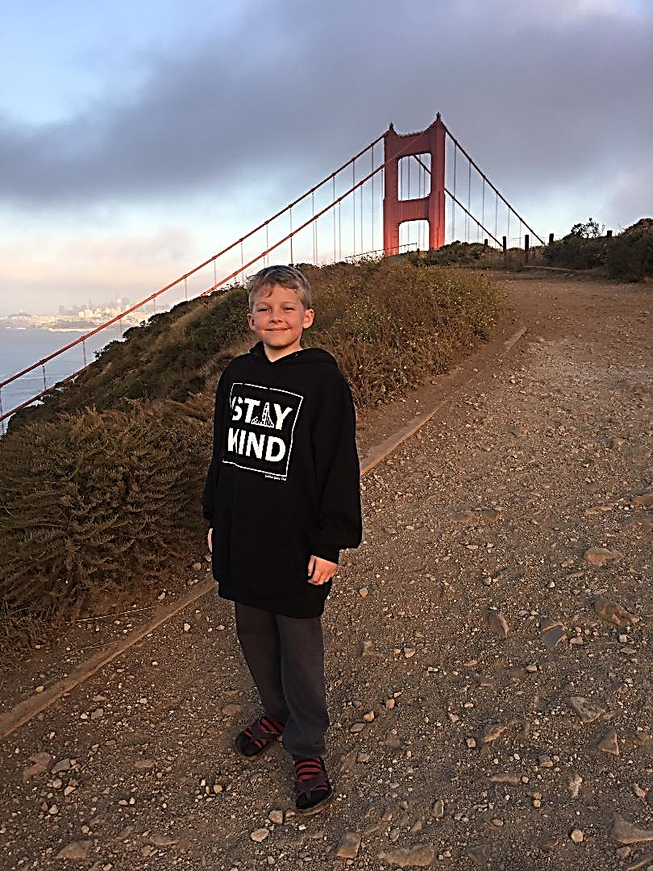
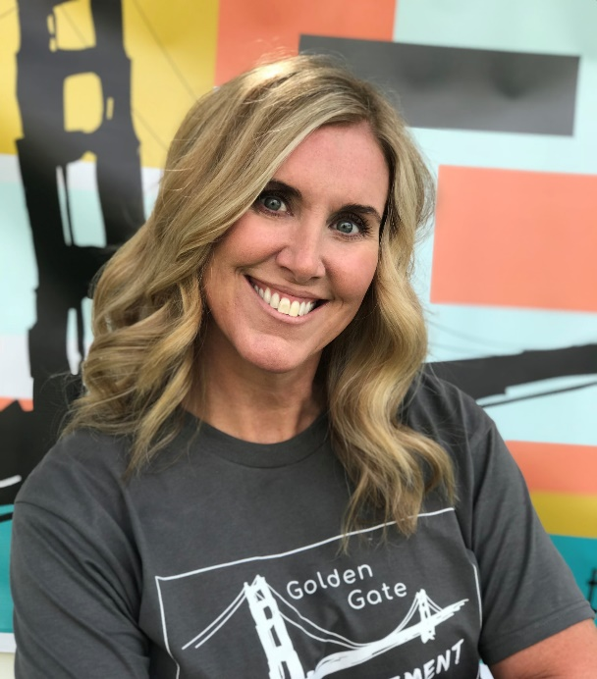
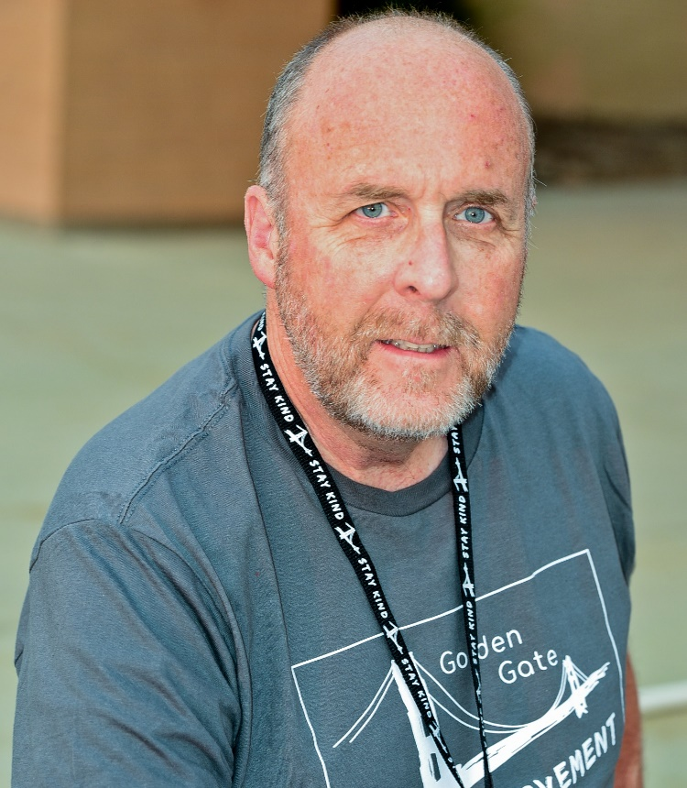
Preston is the 1st
Golden Gate Kid
SAVANAH INSPIRED THE CLUB
MOMMA JO
ONE ACT OF KINDNESS CAN CHANGE THE WORLD
MR. HUGHES
Notes:
An Act of Kindness brought about a Movement that has affected thousands of students. Savanah was a legally blind cheerleader, her disability left her alone unable
To connect with friends. She went to her Principal to see if there was anyone she could reach out to. Her Principal had just received a phone call from a parent who was
Very upset about her daughter not wanting to go to school because she had no friends. Mr. Hughes and Momma Jo connected these two students and they became best
Friends. Momma Jo approached Mr. Hughes and asked if a crew could be formed to help students connect socially. Mike thought that was a great idea and from that point the Golden Gate Club was born.

Slide 3
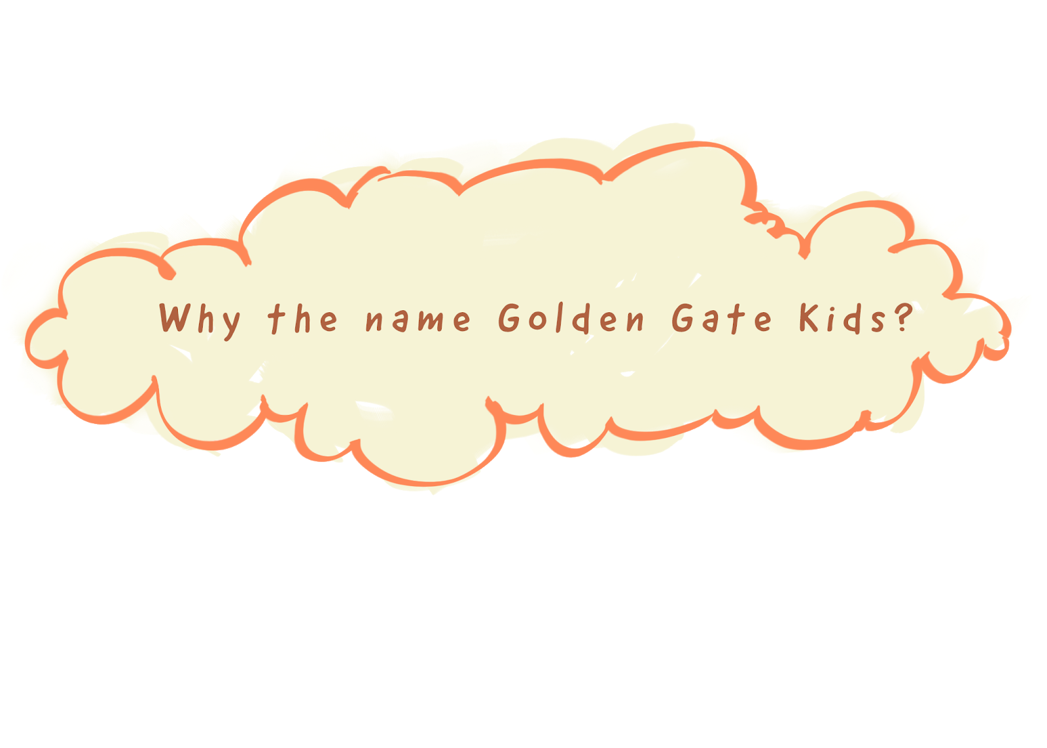
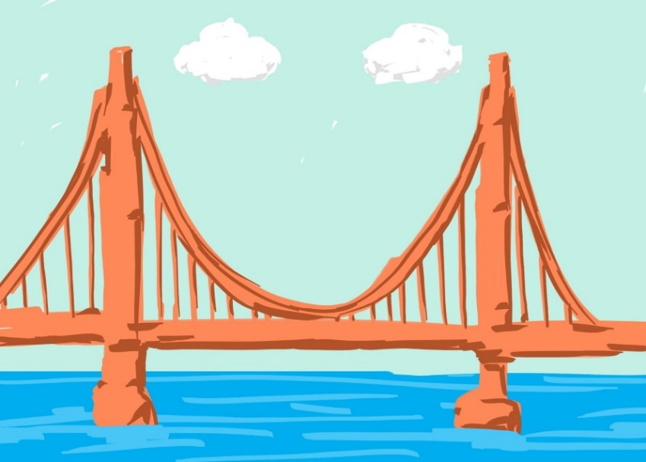
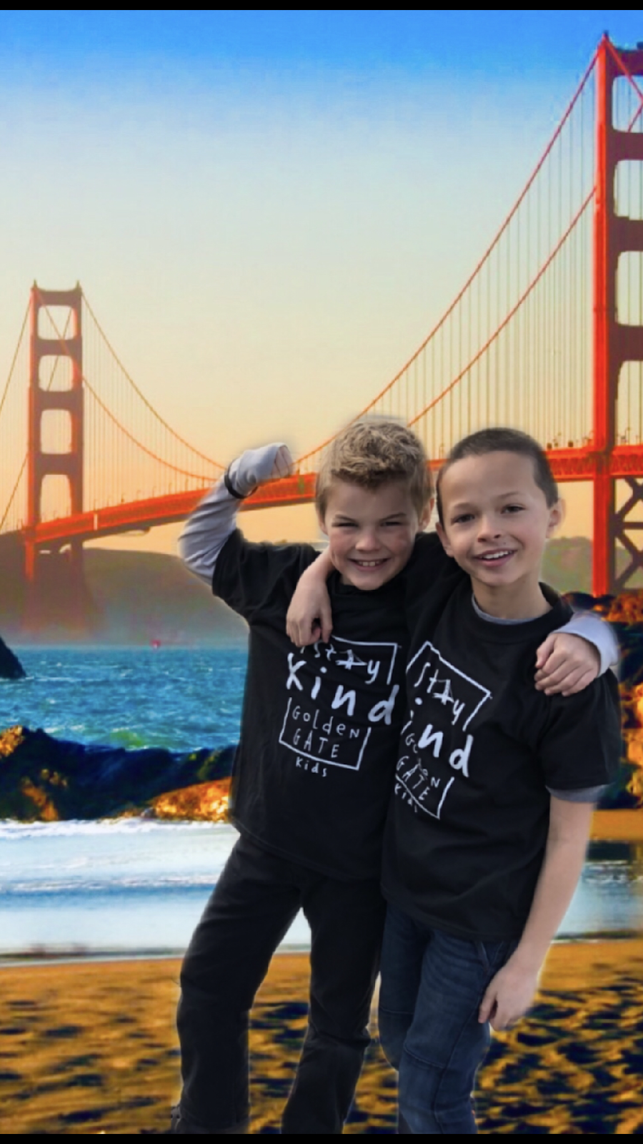
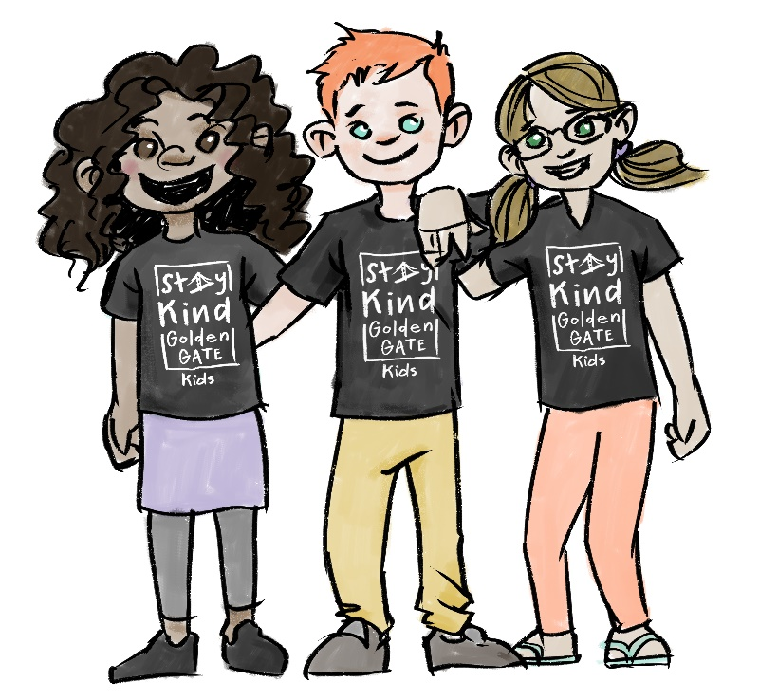
BUILT to CONNECT
A
Community
A SMILE is a BRIDGE
Cultivating
Healthy
Connections
Notes:
The Golden Gate Bridge is an iconic symbol of connection, the bridge was built to connect the isolated community of Marin County to San Francisco. The bridge is also connected with someone who needed “Smile.” A Smile is like a bridge, it helps people connect. A smile says I see you, I know you’re there, you matter. It punctures the lethal bubble of social isolation.
Golden Gate Kids will be the ones who smile, and help their classmates feel connected. The Golden Gate Mottos are STAY KIND and I Will be that person, these shirts along with resources, and soft skill curriculum will empowers students to find commonality with one another as they become that person.

Slide 4
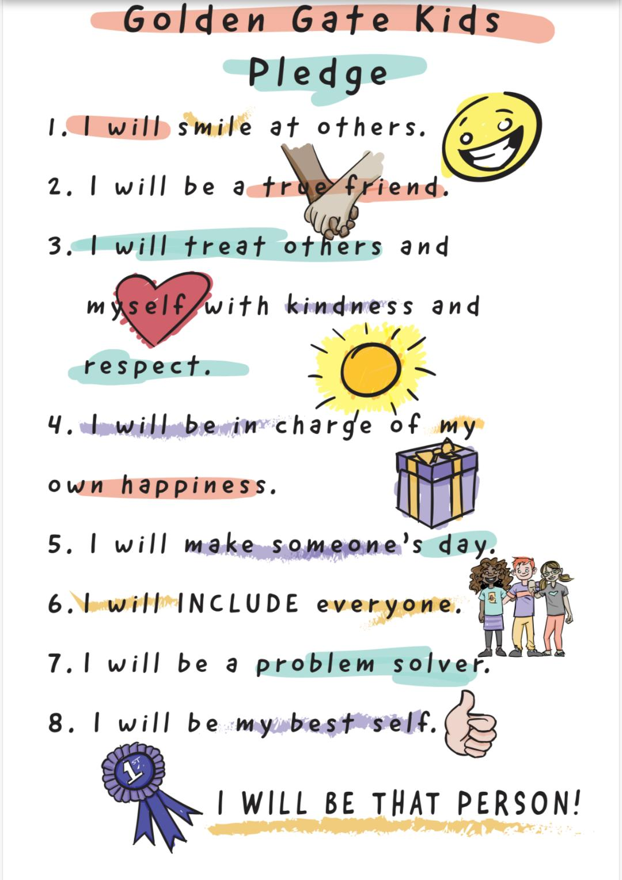
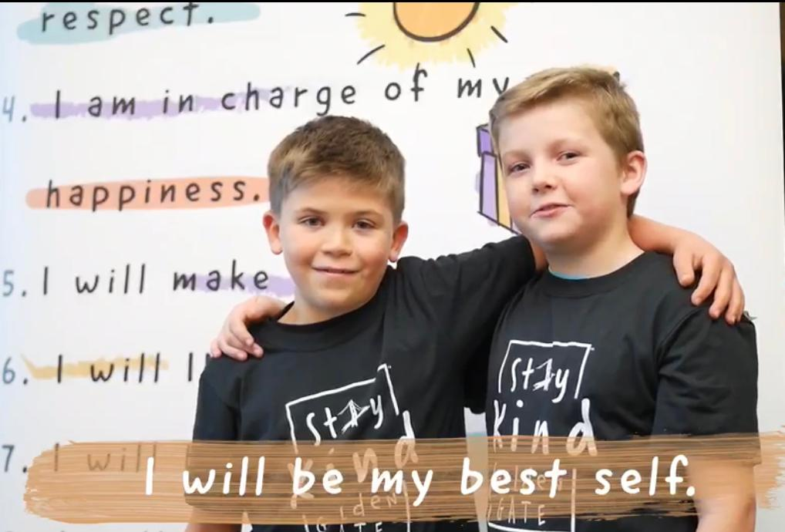
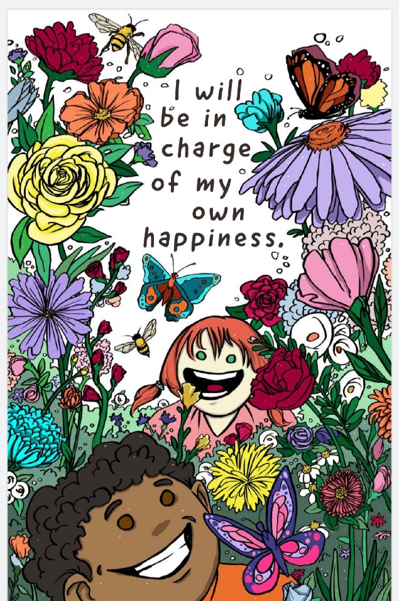
A Promise
To
Self
*Self *Classmates
*Family
*Community
‘
Notes:
Students will learn what a pledge is and that it is a promise to themselves. Students will receive their own pledge card and be encouraged to post it somewhere to remind them to follow the articles of the pledge.
Each month, students will learn to implement a pledge article into their personal lives, apply it to their classmates, their families, and into their communities.
For example, Pledge Article 4 states: I will be in charge of my own happiness (week one) students will learn to accept themselves and not rely on others to make them happy (Week 2) they will apply the pledge to their classmates as they are challenged to accept and see the good in others (Week 3) They will apply the pledge article to their families, and (week 4) into their community.

Slide 5
Notes:
This Pledge means that I will smile, make eye contact and greet others where possible.

Slide 6
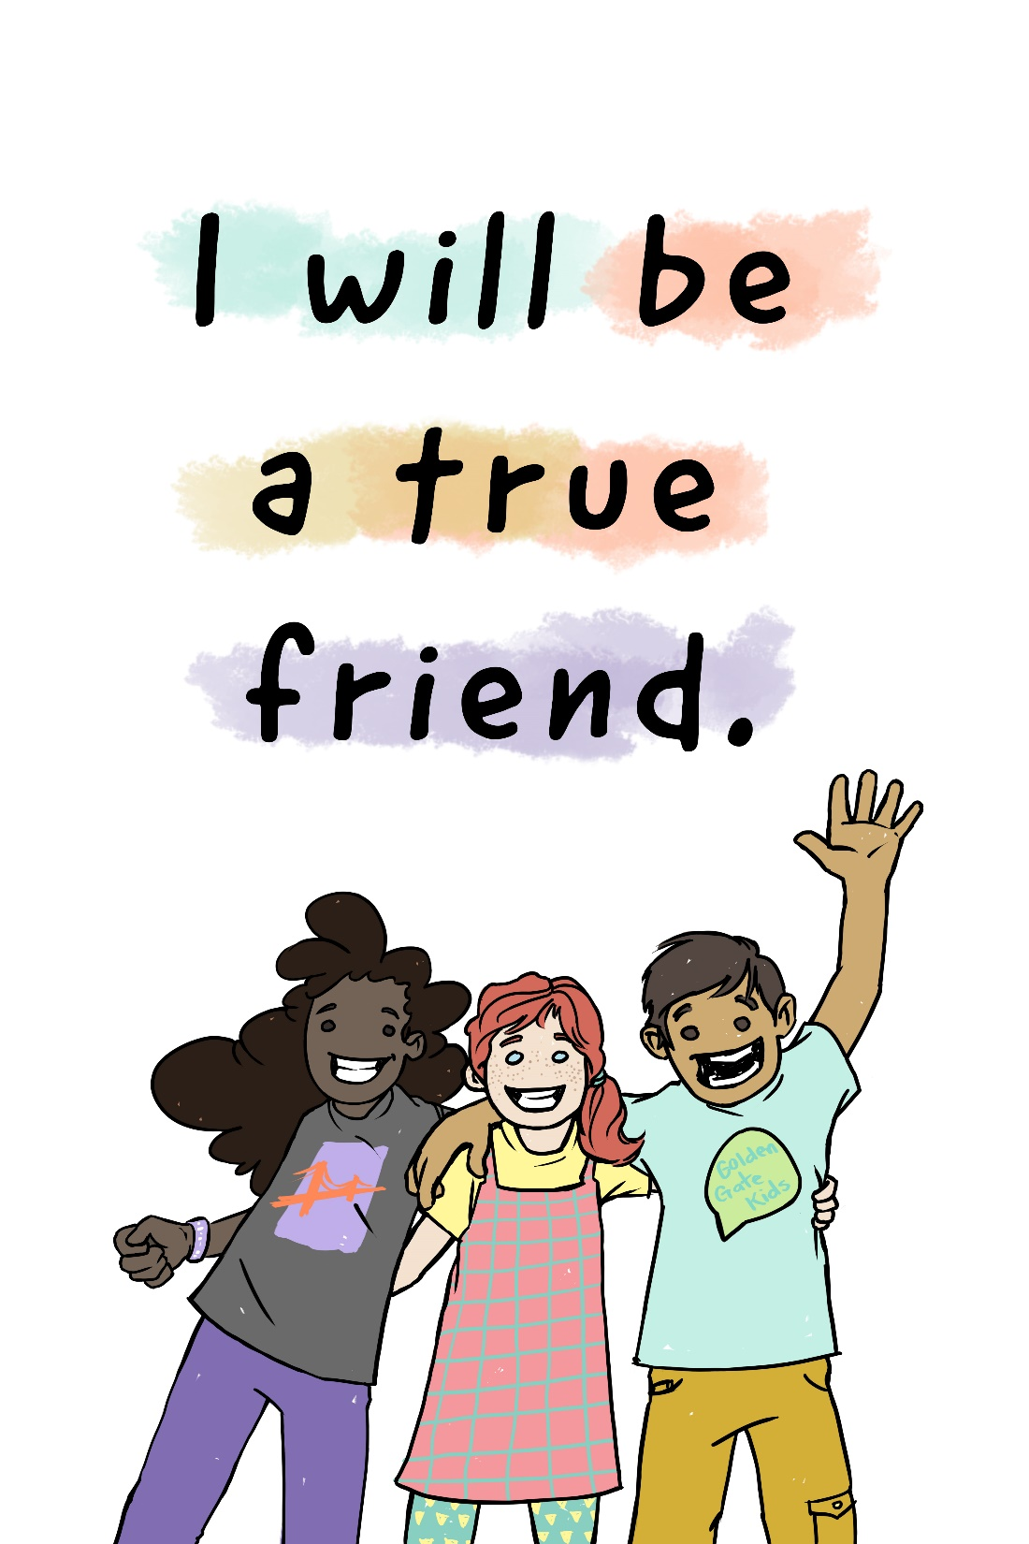
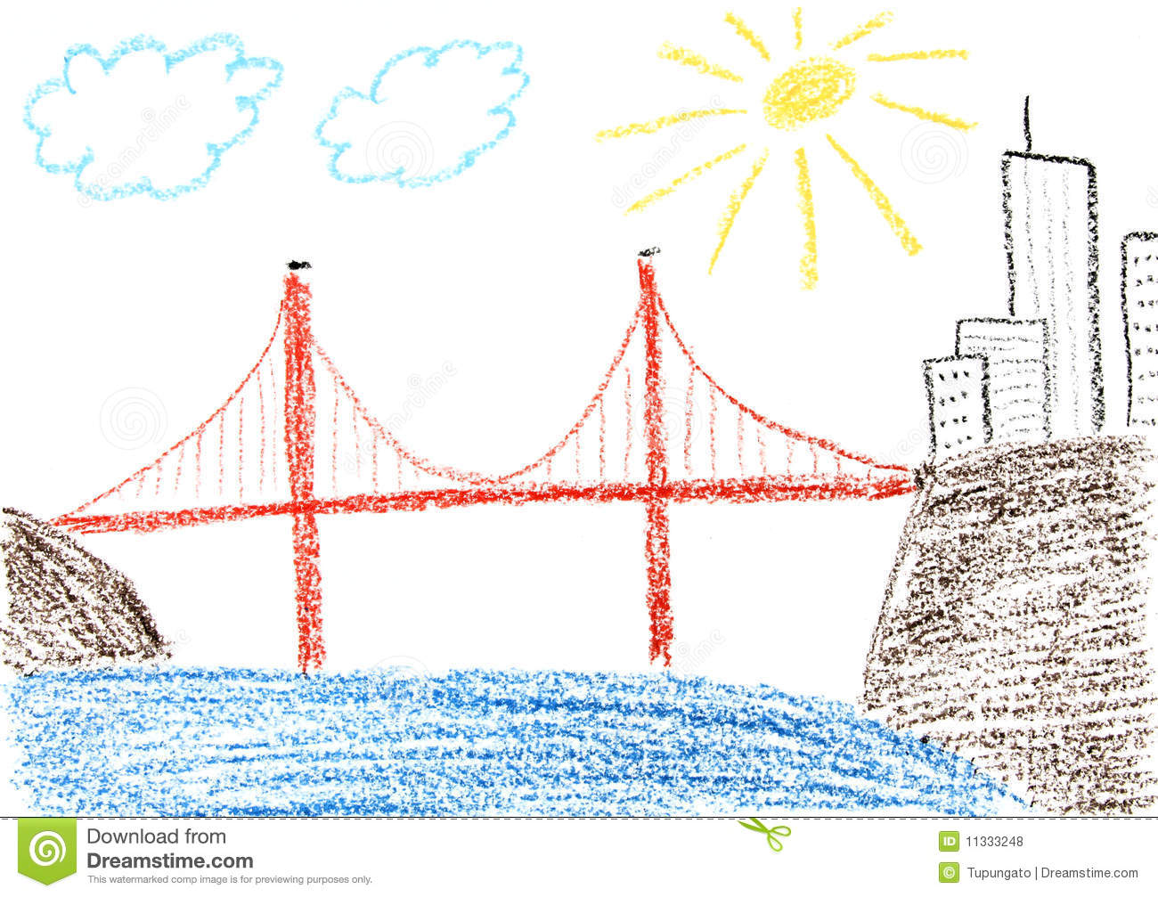
2.
Notes:
I will offer companionship, a listening ear, social support and will BE a positive influence for others.

Slide 7
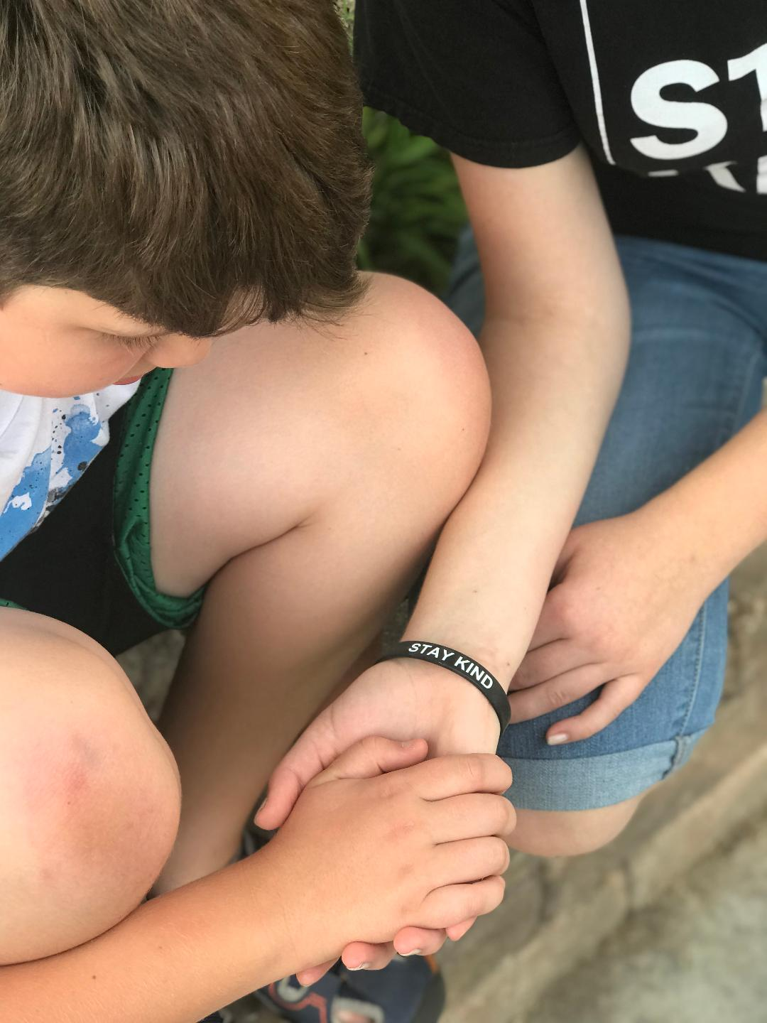
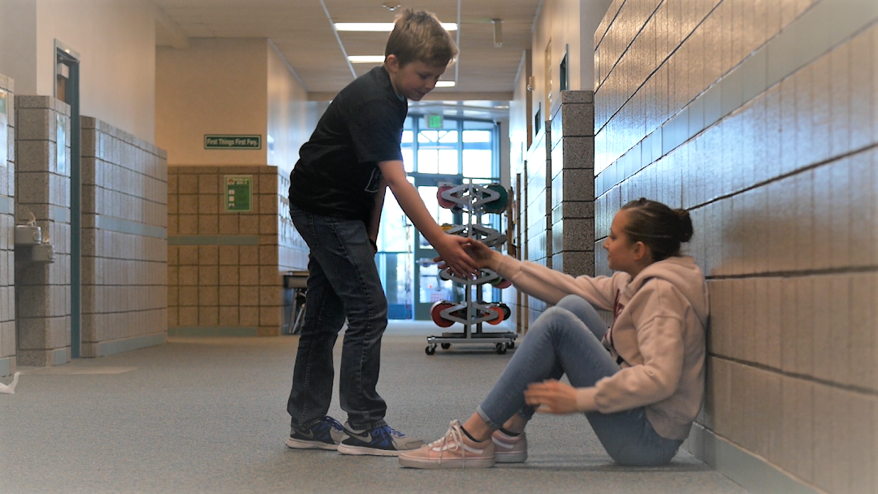
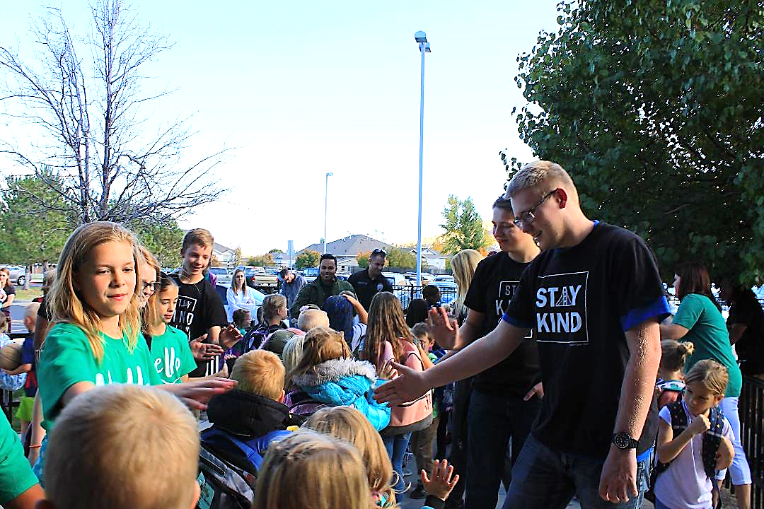
Notes:
I will not bully, cyberbully, or exclude others. I will not believe or spread rumors and talk about others negatively behind their back. I will listen
To different points of view and will be KIND to everyone regardless of their differences.

Slide 8
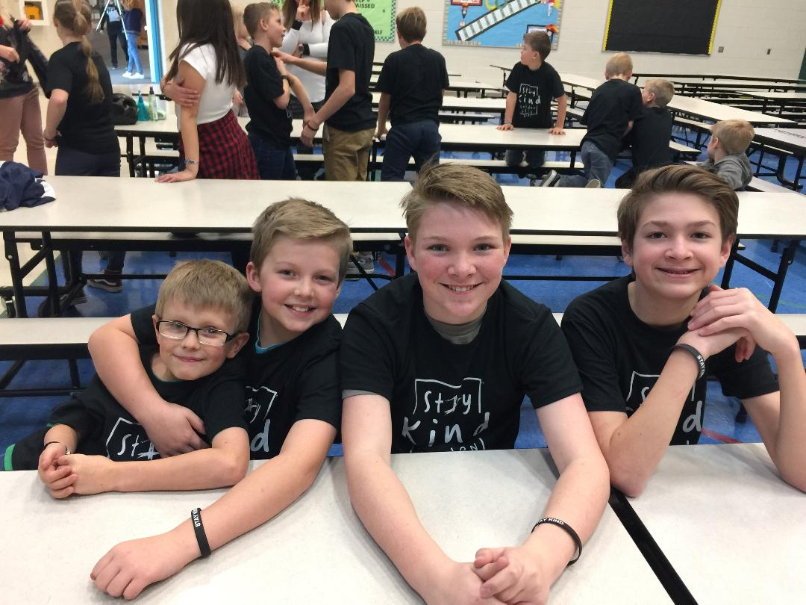
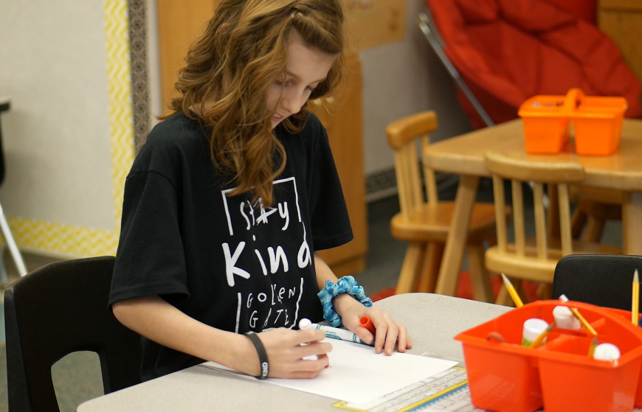
Notes:
I will not rely on or wait for others to make me happy.

Slide 9
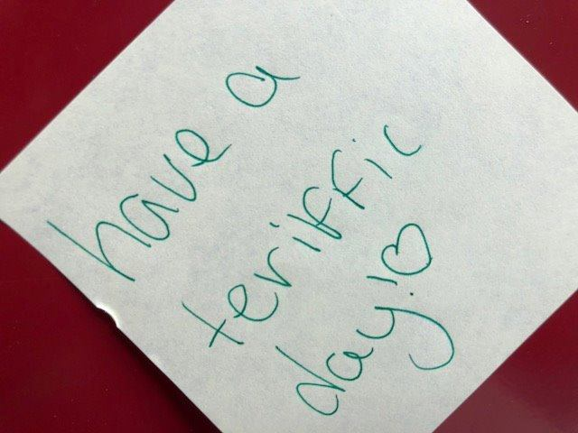
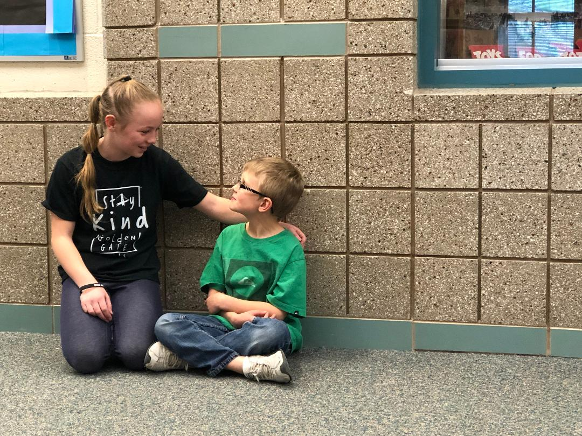
Notes:
I will strive to do acts of kindness everyday.

Slide 10
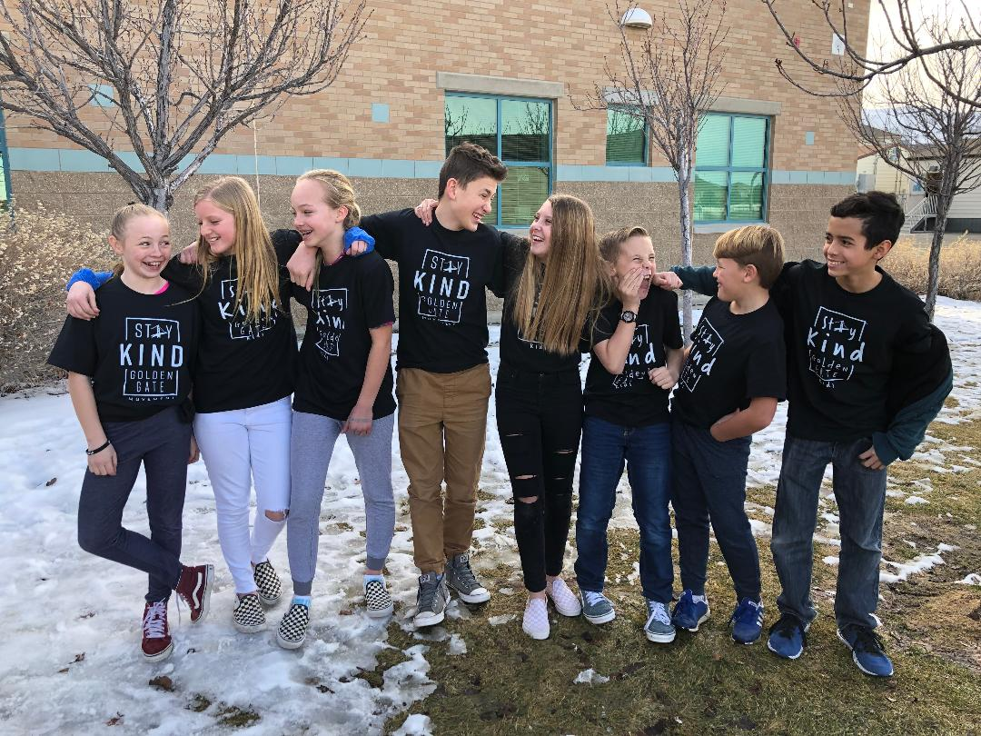
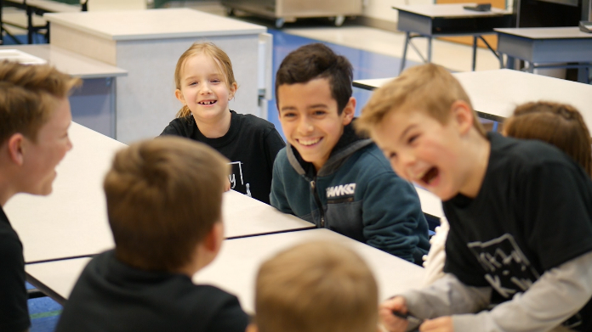
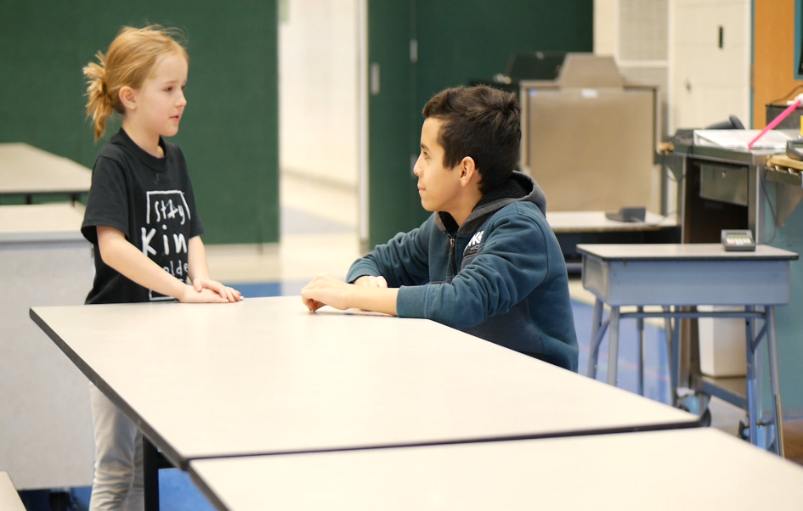
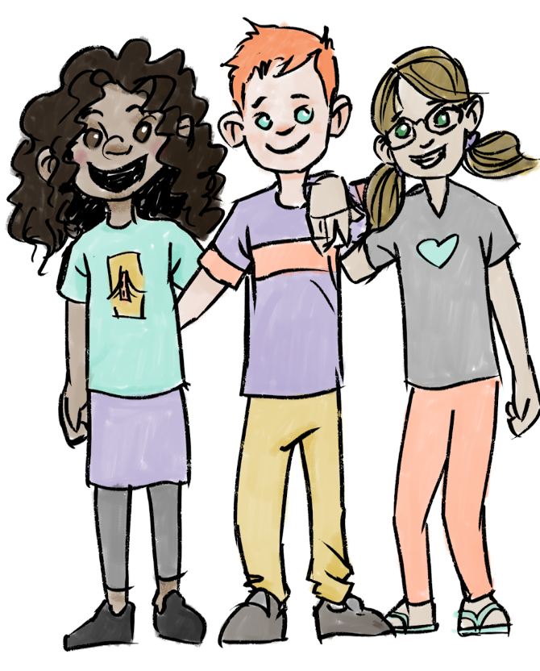
INCLUDE
Notes:
I will help others connect by building a positive environment and inviting and encouraging others to my friend group, to eat lunch with me and attend activities.

Slide 11
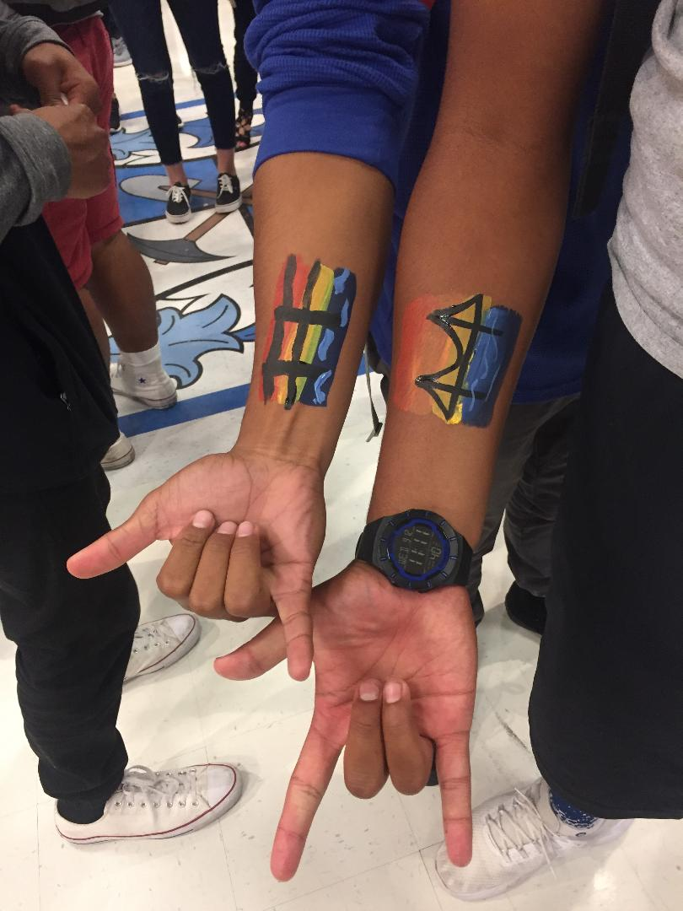
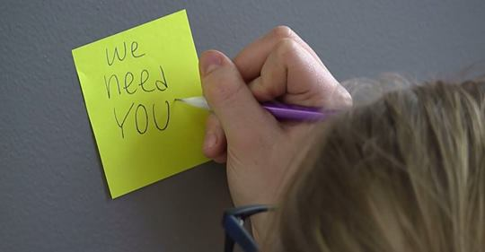
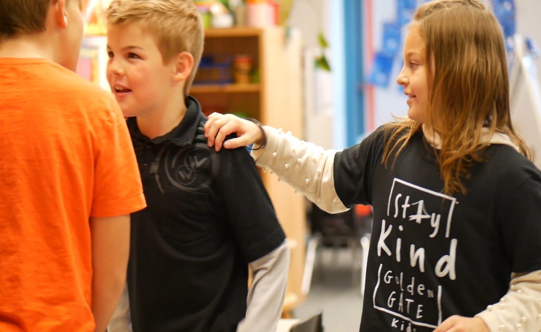
Notes:
I will resolve conflicts honestly and with kindness. I will be slow to anger or take offense.

Slide 12
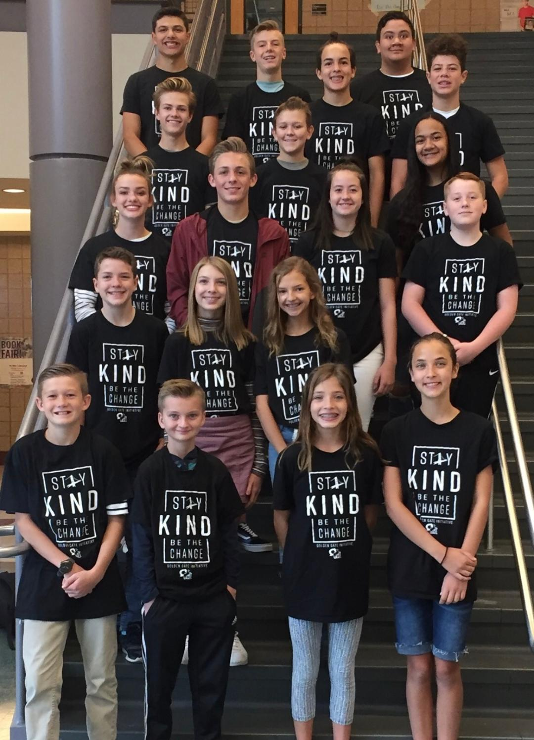
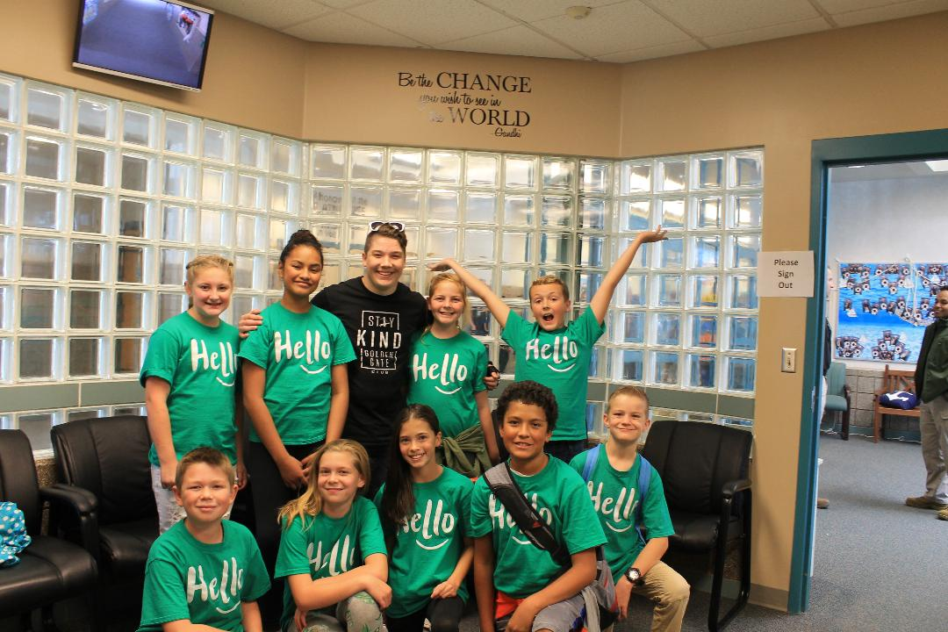
Notes:
I will take care of my physical, spiritual and emotional health. I will also accept help from others.

Slide 13
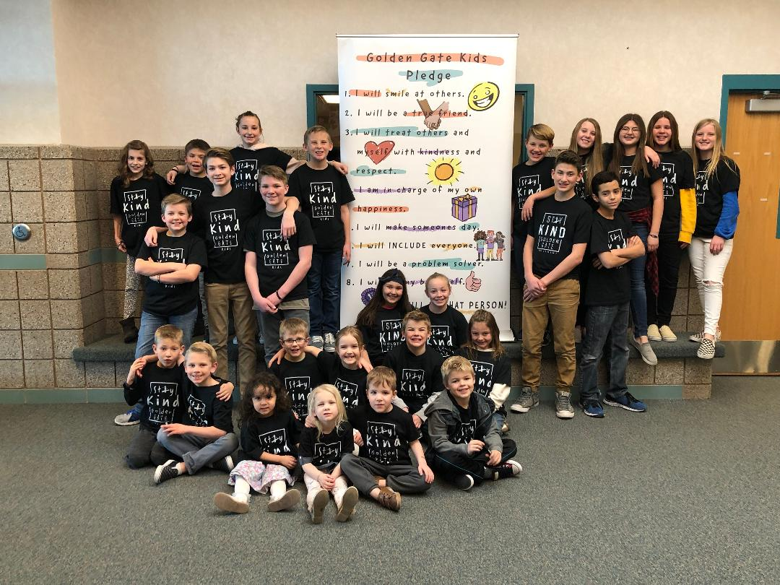
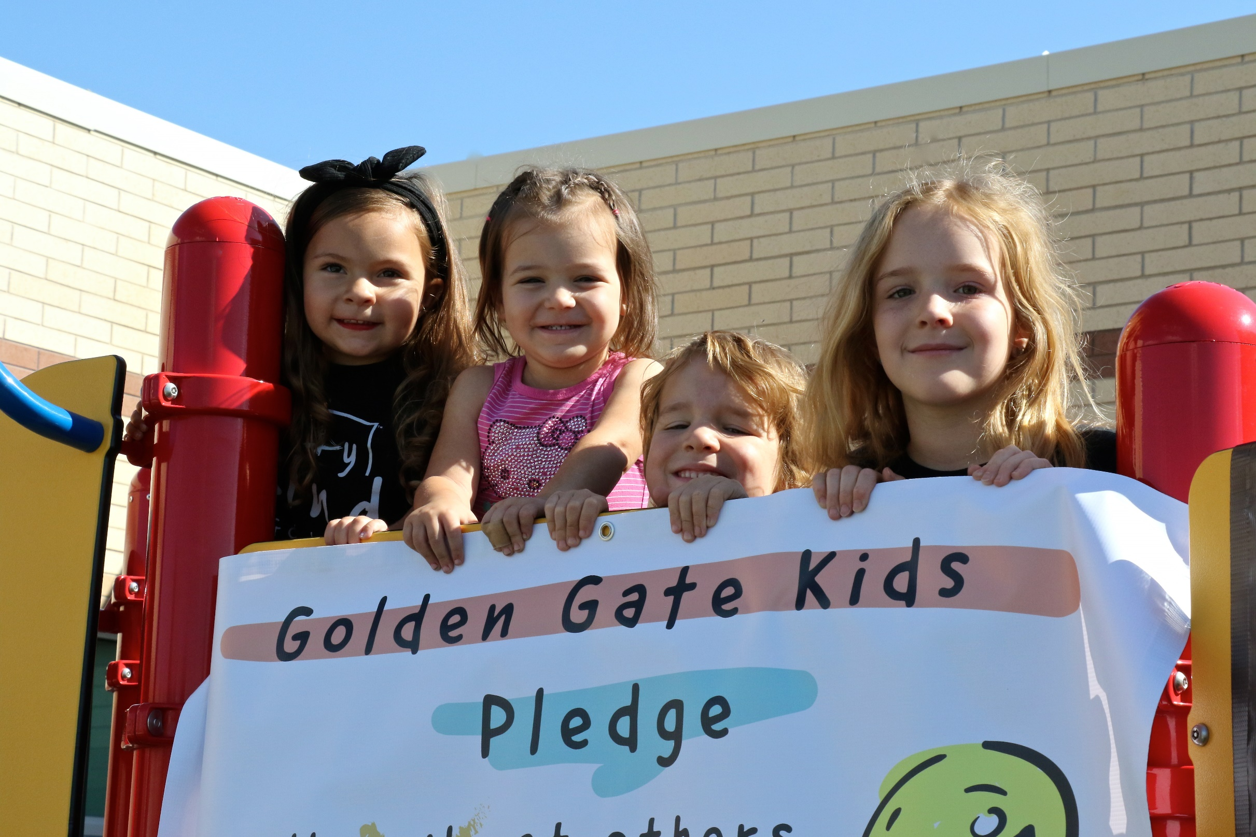
You Can BE A GOLDEN GATE KID
Notes:
Golden Gate Kids will always be Kind and they will always be your friend.

